Slide 1
Updates on LISN Internals and Comparison with CM and DM sensing circuit
Manoj Gulati
16-9-2014

Slide 2
Separating common mode and differential mode conducted EMI using LISN
Paper-1: Devices for the Separation of the Common and Differential Mode Noise-Design and Realization

Slide 3
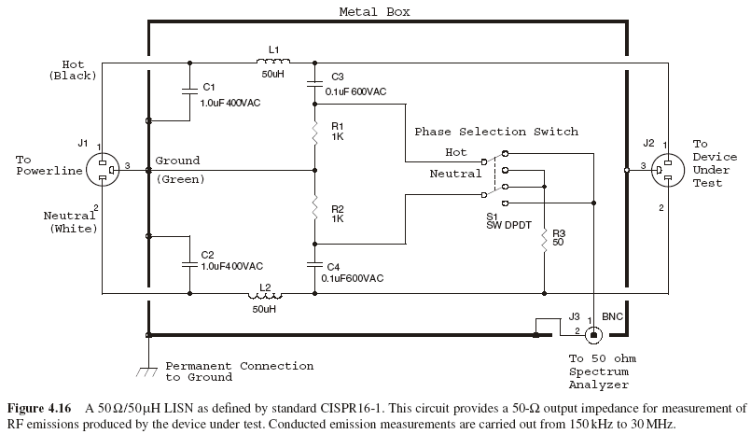
LISN: Line Impedance Stabilization Network as per CISPR Std.

Slide 4
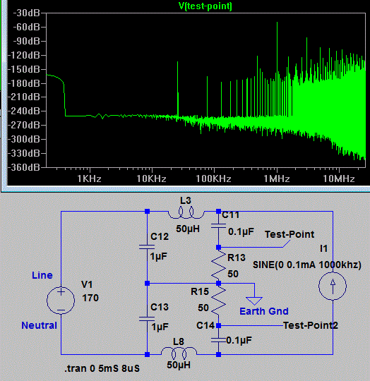
Source: http://electronics-engineering-technologist-technician-bc.ca/Circuits/Circuits.html
LISN: Line Impedance Stabilization Network Spice Model
Low Pass Filter with Fc=22.5kHz
High Pass Filter Fc=31.8kHz

Slide 5
Paper-1: Devices for the Separation of the Common and Differential Mode Noise-Design and Realization
HPF is required here
1:1 Isolation Transformers
Used as a isolation between AC power line and data Acquisition system.
Datasheet LINK
Vp
HPF is required here
Vn
Solution-1 Using addition and subtraction to extract Vcm and Vdm components

Slide 6
Purpose of LISN
Back end act as a Low pass filter on power inlet side to remove background noise and provide constant impedance to the appliance under test.
Front end act as a High pass filter to pass EMI from 9kHz to 30MHz having a differential mode operation but with use of selection knob can provide Common mode as well as Differential mode Conducted EMI.
This can be used to sense Vphase-ground, Vneutral-ground, Vphase-neutral but not simultaneously. As they are using a sliding switch for this selection.
HPF is having std. 50 ohm termination to match data acquisition systems.
Complexities with LISN Design
Air Core Inductors¹ are used for LPF making design of LISN complex and costly.
Basic LISN design is based on CISPR or IEC guidelines.
Different vendors have different types of protection circuits to ensure isolation.
Parameteric value of Inductor in LPF varies with different standards. e.g. 50uH, 120uH, 5uH.
[1] Purpose of these air inductors is to provide linear magnetization curve in comparison with ferromagnetic core based inductors, thus facilitating high frequency operation.

Slide 7
References
Caponet, Marco Chiado, and Francesco Profumo. "Devices for the separation of the common and differential mode noise: design and realization." Applied Power Electronics Conference and Exposition, 2002. APEC 2002. Seventeenth Annual IEEE. Vol. 1. IEEE, 2002.
Guo, Ting, Dan Y. Chen, and Fred C. Lee. "Separation of the common-mode-and differential-mode-conducted EMI noise." IEEE transactions on power electronics 11.3 (1996): 480-488.
Kostov, K. S., et al. "Prediction of the Conducted EMI from DC-DC Switched-Mode Power Converters." (2004).
Nan, Liu, and Yang Yugang. "A common mode and differential mode integrated EMI filter." Power Electronics and Motion Control Conference, 2006. IPEMC 2006. CES/IEEE 5th International. Vol. 1. IEEE, 2006.
US4263549 Patent APPARATUS FOR DETERMINING DIFFERENTIAL MODE AND COMMON MODE NOISE

